Slide 1
Music Style Detector
Project Advisor: Dr. Gheorghi Guzun
Team Members: Kin Wo Chang
Ramin Mousivand
Puneet Tokhi Xin Yu Li
Notes:
‹#›

Slide 2
Project Description
Detect Music Composition Style/Era and Nearest Composer
Classification Using Musical Elements
Caters to both Music Experts and General Public
Educational to General Public
Flask Web App
Notes:
‹#›

Slide 3
Project Deliverables
Web GUI
AI Model
Source Code on GitHub
Cloud Deployment of the App
Notes:
‹#›

Slide 4
Project Dependencies and Concerns
Dataset
Features
Computing Power
Model Performance
System Architecture
Notes:
‹#›

Slide 5
Dataset
Started from GiantMIDI
Examined data distribution
Wrote scripts to clean invalid entries
Selected the subset most representative of each class
Wrote scripts to generate the labels

Slide 6
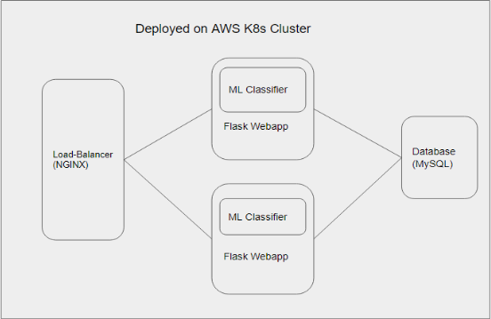
Architecture
Components
Frontend (Flask Jinja)
Backend (Flask)
Database (MySQL)
Load-Balancer(NGINX)
Container (Docker)
Orchestrator (K8s)
Notes:
‹#›

Slide 7
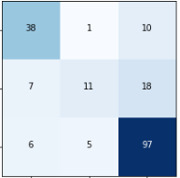
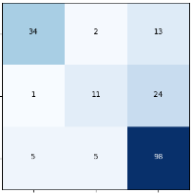
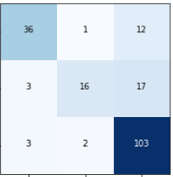
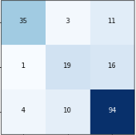
Evaluation, Era
KNN: 0.76, k = 16
Random Forest: 0.74, n = 28
SVM: 0.80, C=13
Multilayer Perceptron: 0.77
knn
random forest
svm
multilayer perceptron
Notes:
‹#›

Slide 8
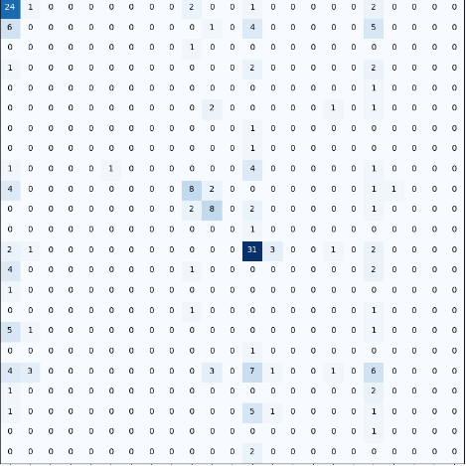
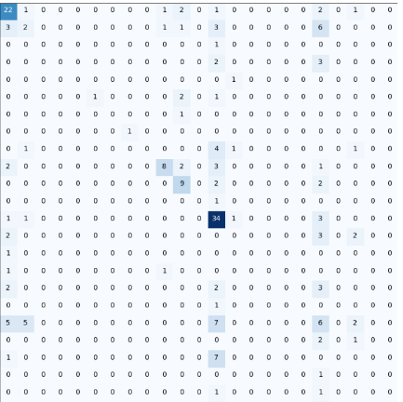
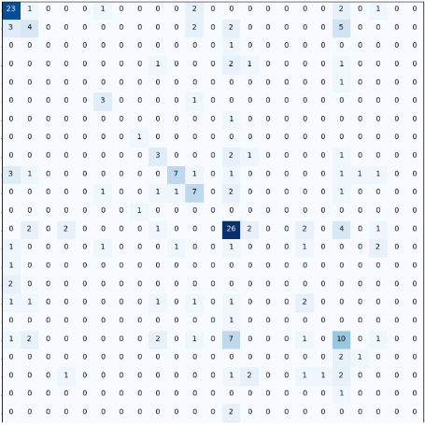
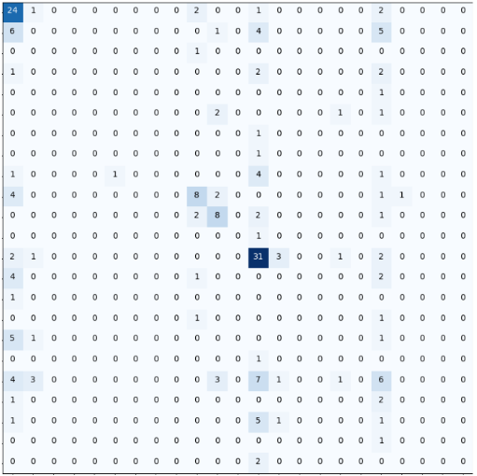
Evaluation, Composer
KNN: 0.40, k = 16
Random Forest: 0.43, n = 71
SVM: 0.45, C=16
Multilayer Perceptron: 0.41
knn
random forest
svm
multilayer perceptron
Notes:
‹#›

